Slide 1

Travel History Visualiser

Slide 2

Why visualize your travel history?
With Interactive mapping we can visualize our travel history and data associated with it in a better way aiding in decision making and pattern analysis
On an enterprise level can aid travel agencies and tourism sector
Why our application?
For improved map visualizations which are filter based.

Slide 3






Tech Stack Used
Google
Takeout
JSON

Slide 4
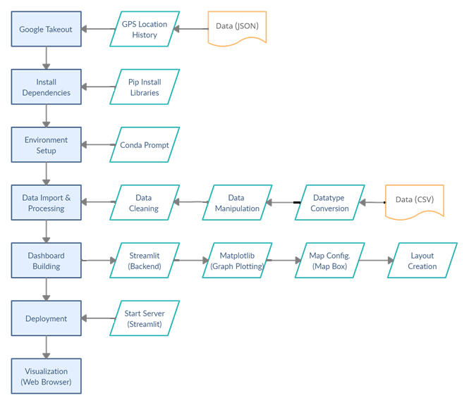
Methodology

Slide 5
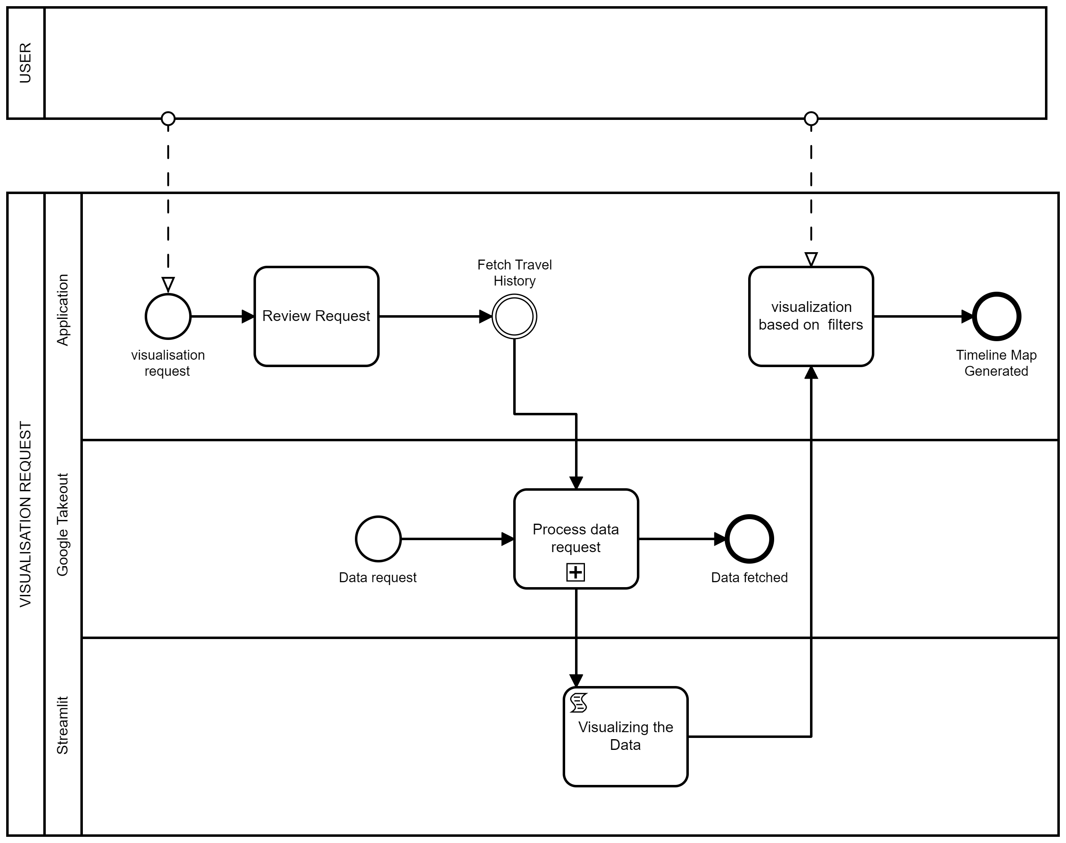
BPMN

Slide 6
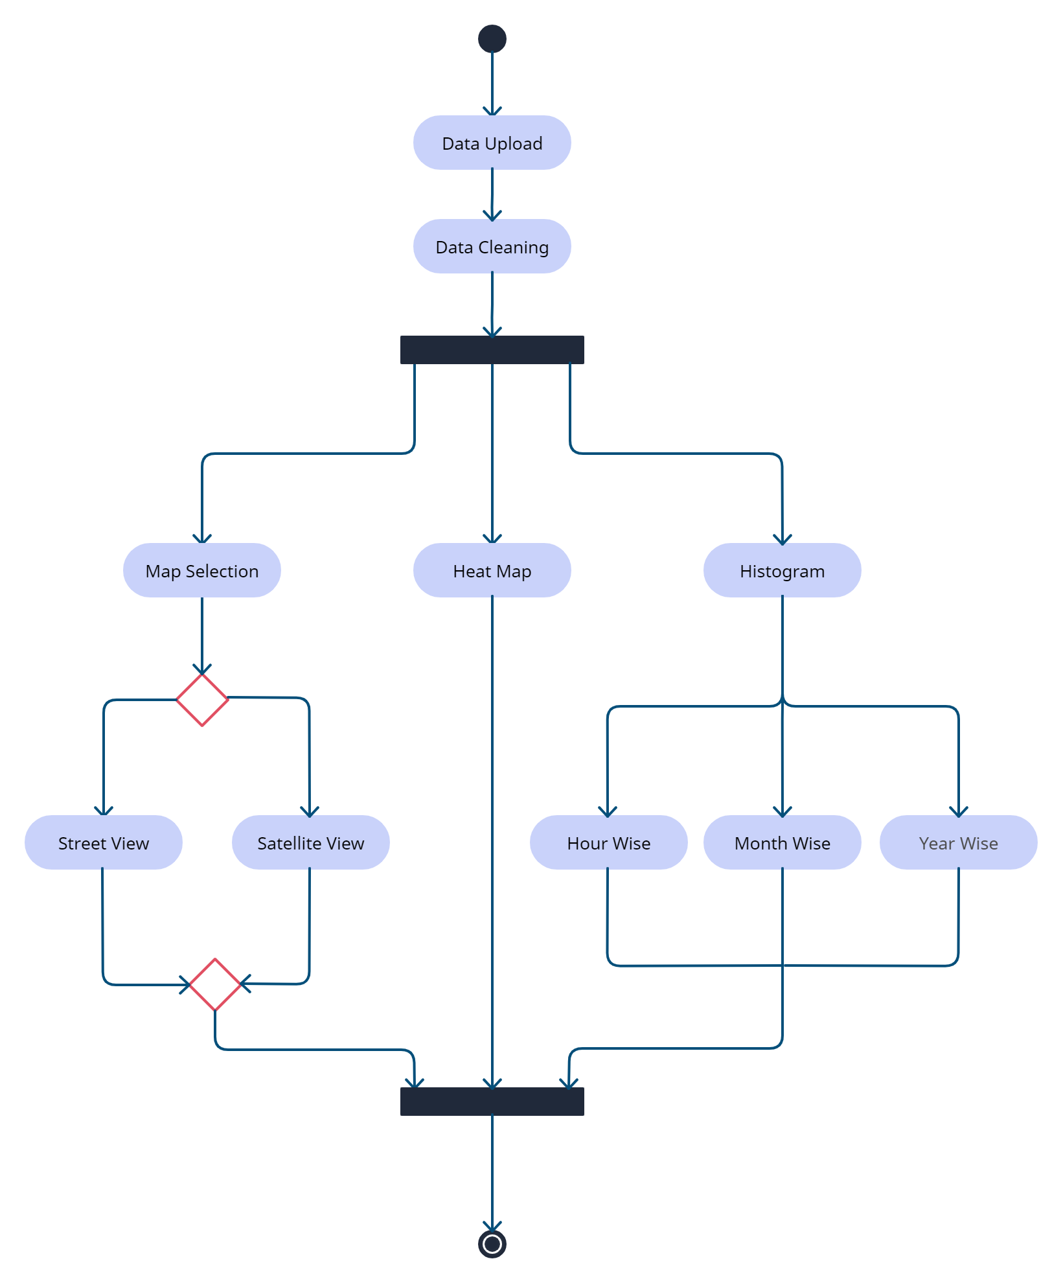
Data Flow Diagram

Slide 7
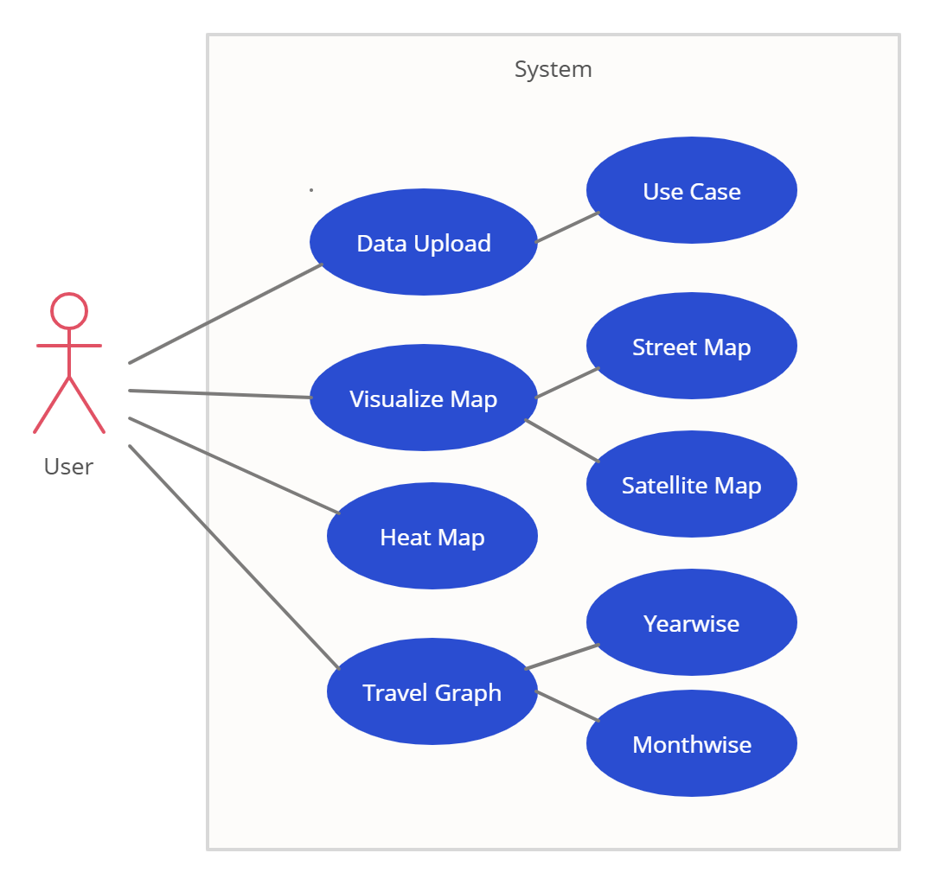
Use Case Diagram

Slide 8
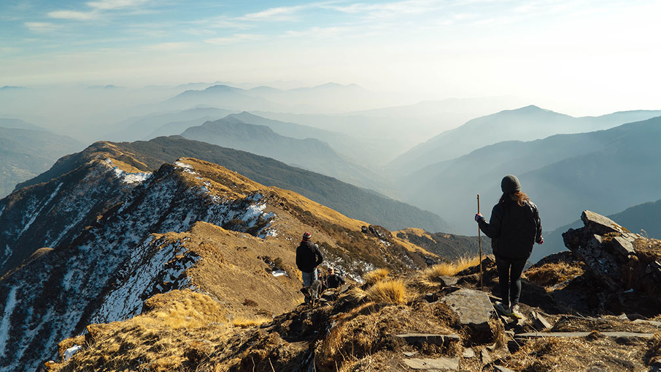
Application Demonstration

Slide 9
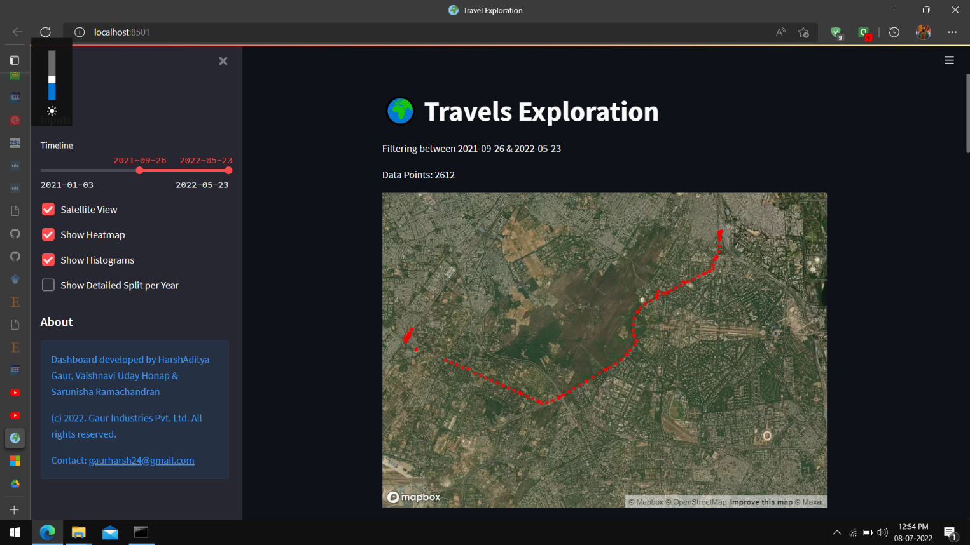
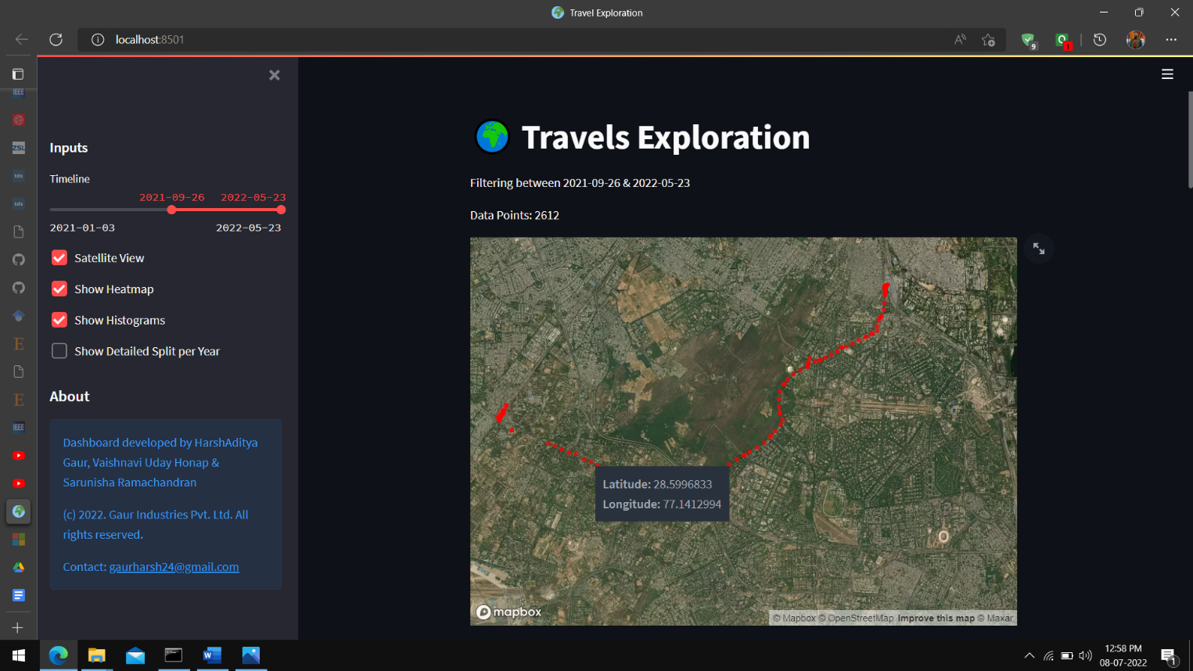
https://drive.google.com/file/d/1m0II_I__hvJ0PYfBNm0k6lCNz5DacSAK/view?usp=sharing

Slide 10
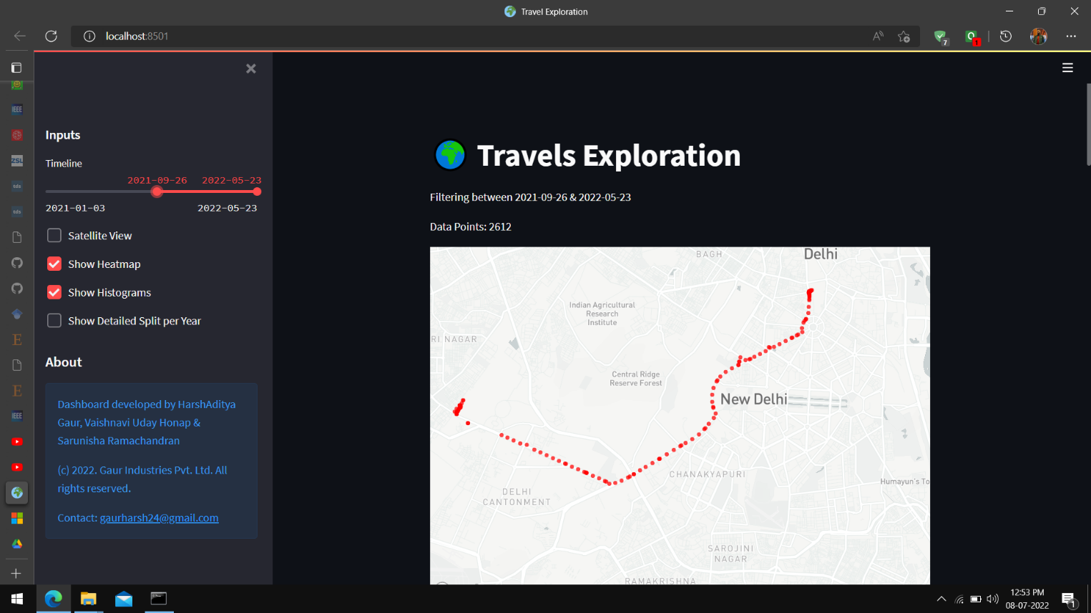
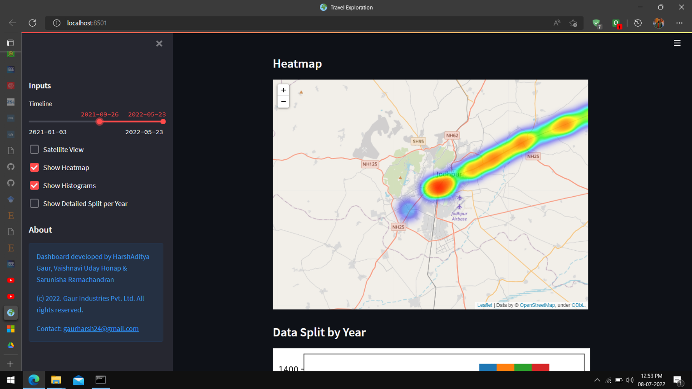
htttps://github.com/HarshAditya23/3.2a-Geospatial-Tech-Project

Slide 11

THANK YOU Harshaditya Gaur Sarunisha R Vaishnavi Uday Honap

